Slide 1
What’s New in C#7 (and Coming in C#8)
Jason Bock
Practice Lead

Slide 2
Personal Info
http://www.magenic.com
http://www.jasonbock.net
https://www.twitter.com/jasonbock
https://www.github.com/jasonbock
jasonb@magenic.com

Slide 3
Downloads
https://github.com/JasonBock/WhatsNewInCSharp7
https://github.com/JasonBock/WhatsNewInCSharp6
https://github.com/JasonBock/Presentations/blob/master/What%E2%80%99s%20New%20in%20C%237.pptx

Slide 4
Overview
Language Evolution
C#7, C#7.1, C#7.2, and C#7.3 Features
Future Directions
Remember…
https://github.com/JasonBock/WhatsNewInCSharp7
https://github.com/JasonBock/WhatsNewInCSharp6
https://github.com/JasonBock/Presentations/blob/master/
What%E2%80%99s%20New%20in%20C%237.pptx

Slide 5

Language Evolution
Est. 2002
http://wilsonwong.me/images/logos/csharplogo.png
Notes:
It’s hard to believe that C# has been around since 2002. Along the way it’s picked up a fair amount of features.

Slide 6
Language Evolution
Version 1
Classes
Structs
Interfaces
Events
Properties
Delegates
Expressions
Statements
Attributes
Literals
https://github.com/dotnet/csharplang/blob/master/Language-Version-History.md#c-10-visual-studionet
Notes:
Version 1 had some “standard” language features that one would arguably expect from an OOP language.

Slide 7
Language Evolution
Version 2
Generics
Partial types
Anonymous methods
Iterators
Nullable types
Getter/setter separate accessibility
Method group conversions (delegates)
Co- and Contra-variance for delegates and interfaces
Static classes
Delegate inference
https://github.com/dotnet/csharplang/blob/master/Language-Version-History.md#c-2-vs-2005
Notes:
Version 2’s biggest addition was generics. That alone made coding easier to write, especially when it came to collections.

Slide 8
Language Evolution
Version 3
Implicitly typed local variables
Object and collection initializers
Auto-Implemented properties
Anonymous types
Extension methods
Query expressions
Lambda expression
Expression trees
Partial methods
https://github.com/dotnet/csharplang/blob/master/Language-Version-History.md#c-3-vs-2008
Notes:
LINQ was the biggest addition for C#3. With it came a whole slew of features to support it.

Slide 9
Language Evolution
Version 4
Dynamic binding
Named and optional arguments
Generic co- and contravariance
Embedded interop types ("NoPIA")
https://github.com/dotnet/csharplang/blob/master/Language-Version-History.md#c-4-vs-2010
Notes:
Verison 4 added some “interesting” features, with dynamic opening the door to C# being a little less type-safe.

Slide 10
Language Evolution
Version 5
Asynchronous methods
Caller info attributes
https://github.com/dotnet/csharplang/blob/master/Language-Version-History.md#c-5-vs-2012
Notes:
Version 5’s biggest (and maybe only) feature is async/await, making asynchronous/concurrent programming easier.

Slide 11

Language Evolution
http://static.hdw.eweb4.com/media/wallpapers_1920x1080/fantasy/1/1/dark-tower-fantasy-hd-wallpaper-1920x1080-5771.jpg
Notes:
But all of C#’s evolution up to version 5 has felt like it’s been done in a dark, brooding tower. It’s not been an open process. Sure, MS has listened to customers, but to directly influence the processes has been difficult at best.

Slide 12

Language Evolution
The .NET Foundation is an independent organization to foster open development and collaboration around the growing collection of open source technologies for .NET
http://www.dotnetfoundation.org/
Notes:
But in 2015, the .NET world changed in a big way. The direction of .NET went OSS. The framework itself was pushed to GitHub in bigger and bigger chunks all the time. .NET Core was introduced, targeting OSes other than MS. It’s opened up a lot of collaboration for developers.

Slide 13
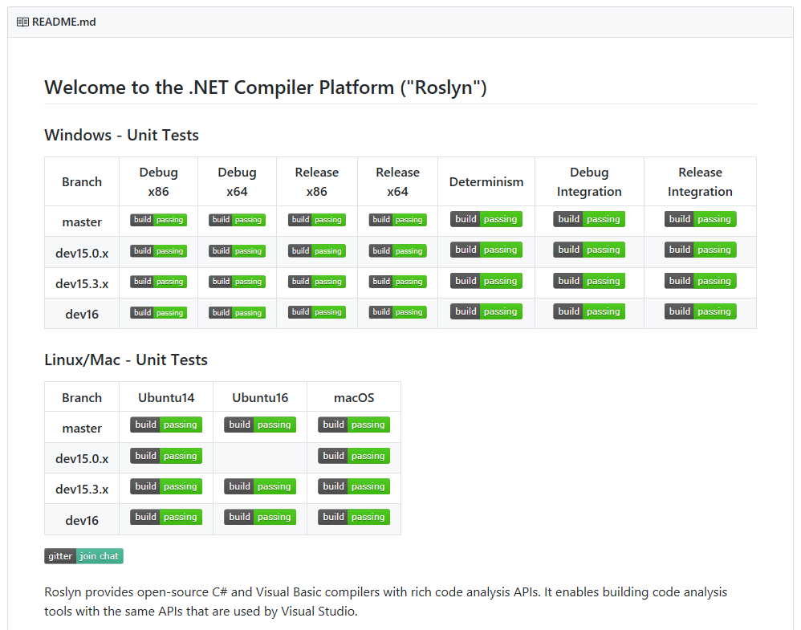
Language Evolution
https://github.com/dotnet/roslyn
Notes:
The language space is completely open now as well. You can download the source code to the compilers and hack away (and submit pull requests if you’d like). You can watch as the language teams discuss current and potentially future changes. This is completely unlike the .NET of 2002.

Slide 14

Language Evolution
https://github.com/dotnet/roslyn/graphs/contributors
Notes:
You can see who has contributed to Roslyn.

Slide 15
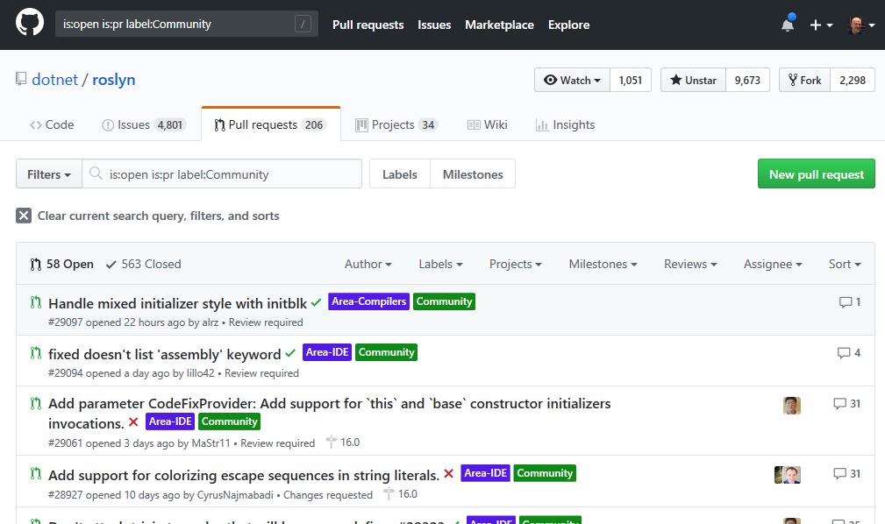

Language Evolution
https://github.com/dotnet/roslyn/pulls?q=is%3Aopen+is%3Apr+label%3ACommunity
Notes:
Recently the team added a “Community” tag so you can see which PRs have been tagged with that.

Slide 16
Language Evolution
Version 6
Compiler-as-a-service (Roslyn)
Import of static type members into namespace
Exception filters
Await in catch/finally blocks
Auto property initializers
Default values for getter-only properties
Expression-bodied members
Null propagator (null-conditional operator, succinct null checking)
String interpolation
nameof operator
Dictionary initializer
https://github.com/dotnet/csharplang/blob/master/Language-Version-History.md#c-6-vs-2015
Notes:
With Version 6, there’s a lot of small, yet useful, features. And it’s interesting to note that a fair amount of these (like string interpolation) went through a lot of changes before it reached its final destination. Some features, like primary constructors, have been dropped for now (though they may come back in a future version). All this work was driven a lot by the community and what really worked best.

Slide 17
Language Evolution
Version 7
Out variables
Pattern matching
Tuples
Deconstruction
Discards
Local Functions
Binary Literals
Digit Separators
Ref returns and locals
Generalized async return types
More expression-bodied members
Throw expressions
https://github.com/dotnet/csharplang/blob/master/Language-Version-History.md#c-70-visual-studio-2017
Notes:
C#7 has continued the trend from C#6, with lots of small, yet useful features.

Slide 18
Language Evolution
Version 7.1
Async main
Default expressions
Reference assemblies
Inferred tuple element names
Pattern-matching with generics
https://github.com/dotnet/csharplang/blob/master/Language-Version-History.md#c-71-visual-studio-2017-version-153
Notes:
But C#7 has bucked a trend by introducing point releases. C#7.1 was released with the VS2017 15.3 release, and we’ll cover those as well in this talk

Slide 19
Language Evolution
Version 7.2
Ref readonly
Interior pointer/Span/ref struct
Non-trailing named arguments
private protected
Conditional ref operator
Digit separator after base specifier
https://github.com/dotnet/roslyn/blob/master/docs/Language%20Feature%20Status.md#c-72
Notes:
7.2 continued the point trend.

Slide 20
Language Evolution
Version 7.3
Enum, delegate, and unmanaged constraints
Ref local re-assignment
Stackalloc initializers
Indexing movable fixed buffers
Custom fixed statement
Improved overload candidates
Expression variables in initializers and queries
Tuple comparison
Attributes on backing fields
https://github.com/dotnet/csharplang/blob/master/Language-Version-History.md#c-73-visual-studio-2017-version-157
Notes:
And now we have 7.3 with VS2017 15.7.

Slide 21
Demo: C#7, C#7.1, C#7.2 and C#7.3 Features
What’s New in C#7

Slide 22
C#7 Features
Binary Literals and Digit Separators
Declaring constants and values using “spacers”
const int FirstValue = 00_11_00_11;
You have to put “0b” in front of the variable though
const int SecondValue = 0b00_11_00_11;
Spacers also work with other declarations
const int ThirdValue = 0x3_3;

Slide 23
C#7 Features
Local functions
If you have processing that is reused in a function but only in that function, declare a local function
Local functions can “see” variables in the function
Declaration of the local function can be anywhere within the function
private static void UseLocalFunction()
{
uint Collatz(uint value) =>
value % 2 == 1 ? (3 * value + 1) / 2 : value / 2;

Slide 24
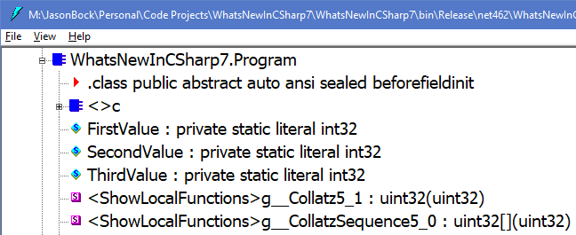
C#7 Features
Local functions
The time to invoke local functions is the same to invoke a private function

Slide 25
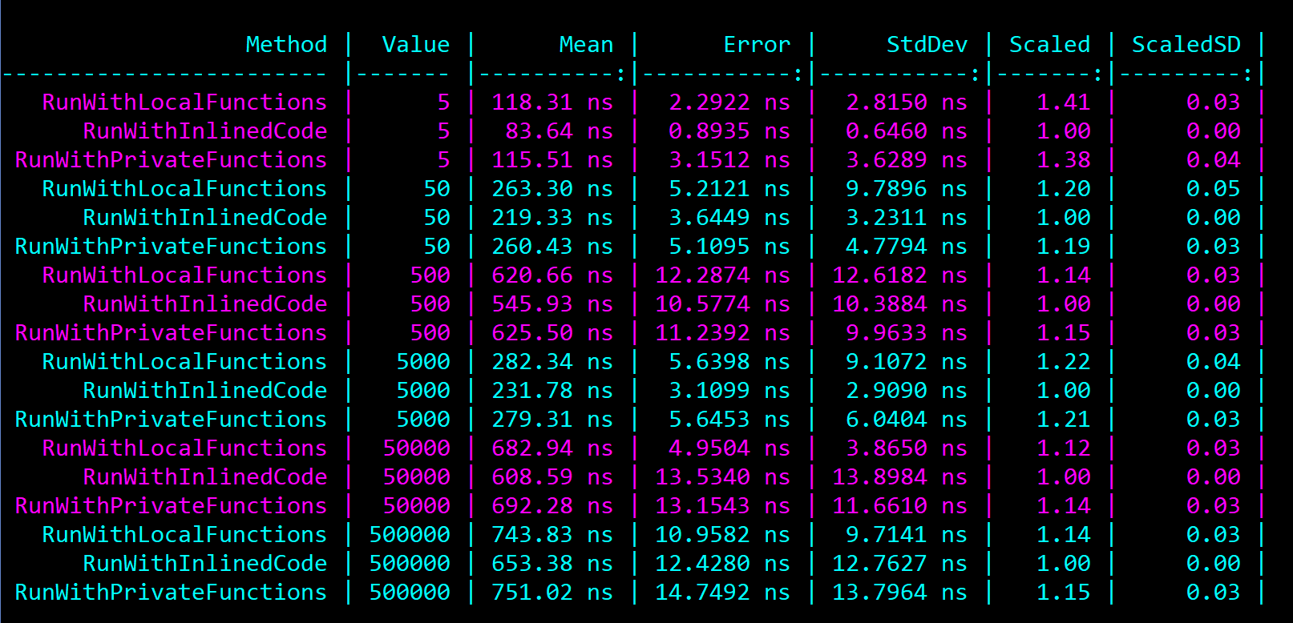
C#7 Features
Local functions
The time to invoke local functions is the same to invoke a private function

Slide 26
C#7 Features
Out variables
Typically with out variables you need to declare the variable first, then pass it into the method
Now you can do that all in one line
if (int.TryParse(value, out var thirdWay))

Slide 27
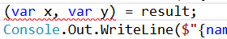
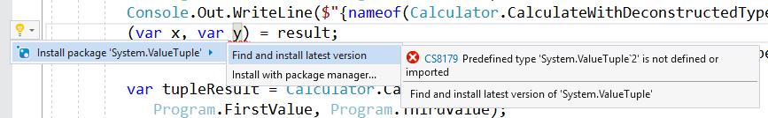
C#7 Features
Tuples and Deconstruction
You need to reference System.ValueTuple for this to work
This makes it easy to return multiple values
You can also turn an object into a tuple if it implements Deconstruct()

Slide 28
C#7 Features
Pattern matching
Pattern matching “are syntactic elements that can test that a value has a certain ‘shape’, and extract information from the value when it does.” - https://blogs.msdn.microsoft.com/dotnet/2017/03/09/new-features-in-c-7-0/
It’s not as full-featured as pattern matching in languages like F# and Rust, but it’s a start
private static void CheckThings(Thing thing)
{
switch (thing)
{
case SomeThing someThing22 when someThing22.Value == 22:
Console.Out.WriteLine(
$"{nameof(SomeThing)} with {nameof(Thing.Value)} == 22");
break;

Slide 29
C#7 Features
Ref returns and locals
If you return a value type from a method, the value is copied
For perf reasons, you may want to have “by reference” semantics
With ref returns and ref locals, you can now do that.
ref var fastStruct1 = ref fastList[50];
ref var fastStruct2 = ref fastList[50];
fastStruct1.Value1 = 22;
Console.Out.WriteLine(
$"{nameof(fastStruct2)}.{nameof(fastStruct2.Value1)} is {fastStruct2.Value1}");

Slide 30
C#7 Features
Generalized async return types
Typically async methods return Task or Task<T>
Now you can return “Task-like” tasks objects
One example on how to do this is ValueTask<T>: https://github.com/dotnet/corefx/blob/5a6d8ca975b512eeeea7404c740afcf865128405/src/System.Threading.Tasks.Extensions/src/System/Threading/Tasks/ValueTask.cs
private static void ShowValueTask()
{
ValueTask<int> ReturnValueAsync() =>
new ValueTask<int>(22);

Slide 31
C#7 Features
More expression-bodied members and throws expressions
You can now do expression-bodied members with constructors, finalizers and accessors
You can also throw exceptions from expressions, which makes the “if parameter is null throw ArgumentNullException” pattern easier to write.
public sealed class ExpressedPerson
: INotifyPropertyChanged
{
public event PropertyChangedEventHandler PropertyChanged;
private int id;
private string name;
public ExpressedPerson(int id) => this.id = id;
public ExpressedPerson(int id, string name)
: this(id) =>
this.name = name ?? throw new ArgumentNullException(nameof(name));

Slide 32
C#7.1 Features
Async Main
Asynchronous methods cause the entry point to be Main(), but that wasn’t allowed. Now you can write that!
Note that the SynchronizationContext is not set
class Program
{
static async Task Main(string[] args) =>
await Program.DoValueTaskAsync();
private static async Task DoValueTaskAsync()
{
ValueTask<int> ReturnValueAsync() =>
new ValueTask<int>(22);
Console.Out.WriteLine(await ReturnValueAsync());
Console.Out.WriteLine(SynchronizationContext.Current == null);
}

Slide 33
C#7.1 Features
Default expressions
You could set variables and arguments to their default value using default()
Now you can just use the default keyword by itself
private static void ShowDefaultLiterals()
{
int DoSomething(int x, string y) =>
x == default && y == default ? default : 22;
Console.Out.WriteLine(DoSomething(default, "data"));
Console.Out.WriteLine(DoSomething(22, default));
Console.Out.WriteLine(DoSomething(default, default));
Console.Out.WriteLine(DoSomething(0, null));

Slide 34
C#7.1 Features
Inferred tuple element names
Before 7.1, assigning a variable tuple values did not infer names.
Now it does!
private static void ShowInferredTupleNames()
{
var x = (id: 3, name: "name");
var y = (x.id, x.name);
Console.Out.WriteLine($"{y.id}, {y.name}");
}

Slide 35
C#7.1 Features
Pattern matching with generics
There was an issue in 7.0 where generics couldn’t be used in pattern-matching
In 7.1 this has been relaxed/fixed
private static void ShowPatternMatchingWithGenerics()
{
void HandleThing<T>(T thing) where T : Thing
{
if(thing is SomeThing someThing)
{
Console.Out.WriteLine($"It's {someThing.GetType().Name}");
}
else if (thing is AnotherThing anotherThing)
{
Console.Out.WriteLine($"It's {anotherThing.GetType().Name}");
}
else
{
Console.Out.WriteLine($"Unknown {nameof(Thing)}");
}
}
HandleThing(new SomeThing());
HandleThing(new AnotherThing());
HandleThing(new SneakyThing());
}

Slide 36
C#7.2 Features
Structs and readonly features
You can declare a parameter to be readonly via the in keyword
You can also make return values that are structs to be readonly
Finally, you can also declare structs to be readonly
private static void PassMutuableStruct(in MutuableStruct data)
ref readonly var value = ref Program.HandleReturnedValue();
public readonly struct ReadonlyStruct

Slide 37
C#7.2 Features
Span<T>
This is a new type (along with Memory<T>) that allows for safe, low-level data manipulation
In a lot of cases, you can get away with not allocating memory in certain scenarios
var input = "22,33";
var inputSpan = input.AsSpan();
var firstSpan = int.Parse(inputSpan.Slice(0, commaPosition));
var secondSpan = int.Parse(inputSpan.Slice(commaPosition + 1));

Slide 38
C#7.2 Features
Non-trailing named arguments
Before C#7.2, you had to put optional values at the end of the call, even if you used named arguments
Now, the order doesn’t matter
private static void MixNamedAndOptionalArguments(
int intValue, Guid guidValue, string stringValue = default)
Program.MixNamedAndOptionalArguments(
guidValue: Guid.NewGuid(), stringValue: "My value", intValue: 22);

Slide 39
C#7.2 Features
Digit separator after base specifier
Digit separators were added in C#6, but you couldn’t add an underscore after the specifier.
Now, you can!
var data = 0b_100_100_1;
Console.Out.WriteLine((char)data);

Slide 40
C#7.2 Features
Private protected accessibility
A member declared private protected can be accessed within a subclass of its container if that subclass is in the same assembly as the member.
If you used protected and internal, this would allow classes outside of the assembly to override it
// In Assembly1...
public abstract class ClassWithPrivateProtectedMethod
: ValueRetriever
{
private protected virtual int GetValue() => 22;
}
// In Assembly2 that references Assembly1...
public sealed class MyClassDerivingFromClassWithPrivateProtectedMethod
: ClassWithPrivateProtectedMethod
{
// Can't override GetValue() here.
public override int Data => int.MinValue;
}

Slide 41
C#7.3 Features
Enum, delegate, and unmanaged constraints
Before this feature, you couldn’t use these types as generic constraints
Now you can. Note that you have to use the type name (e.g. Enum)
Unmanaged is for blittable types
private static void UseEnumConstraints<T>(T value)
where T : Enum

Slide 42
C#7.3 Features
Tuple comparison
You can now compare tuples.
var value1 = (3, 4);
var value2 = (4, 5);
var value3 = (3, 4);
Console.Out.WriteLine(
$"{nameof(value1)}:{value1} == {nameof(value2)}:{value2} is {value1 == value2}");
Console.Out.WriteLine(
$"{nameof(value1)}:{value1} == {nameof(value3)}:{value3} is {value1 == value3}");
Console.Out.WriteLine(
$"{nameof(value2)}:{value2} == {nameof(value3)}:{value3} is {value2 == value3}");

Slide 43
C#7.3 Features
Attributes on backing fields
If you have a property with a compiler-based backing field, you don’t have access to that backing field
You can now declare an attribute for that backing field
[Serializable]
public sealed class SerializableData
{
public Guid Id { get; set; }
[field: NonSerialized]
public string SSN { get; set; }
}

Slide 44

Future Directions
https://dialectline.files.wordpress.com/2012/04/crystal_ball1.jpg
Notes:
So, where will C# go from here? As with any crystal ball gazing, sometimes the best we can do is guess. But with C# being OSS, it’s easier to see the roadmap, so let’s talk about some of the features that may show up in the future.

Slide 45
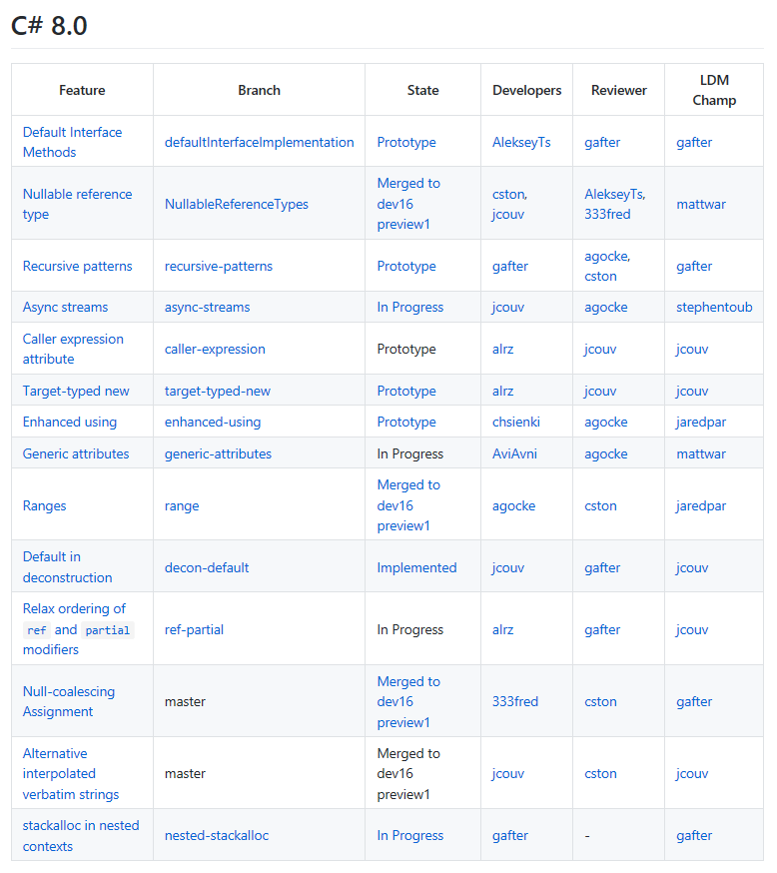
Future Directions
https://github.com/dotnet/roslyn/blob/master/docs/Language%20Feature%20Status.md
Notes:
Here’s what might be coming in the future.

Slide 46
C#8 – Ranges
foreach (var i in 0..10)
{
Console.WriteLine(i); // 0, 1, 2, 3...
}
Notes:
Ranges…they’ve been in other languages, and now they might be coming to C#

Slide 47
C#8 – Default Interface Methods
interface IA
{
void M() { WriteLine("IA.M"); }
}
class C : IA { } // OK
IA i = new C();
i.M(); // prints "IA.M"
Notes:
This would allow you to have implementations for members on an interface.

Slide 48
C#8 – Nullable Reference Types
string? n; // Nullable reference type
string s; // Non-nullable reference type
n = null; // Sure, it's nullable
s = null; // Warning! Shouldn't be null!
s = n; // Warning! Really!
WriteLine(s.Length); // Sure; it's not null
WriteLine(n.Length); // Warning! Could be null!
if(n != null) { WriteLine(n.Length); } // Sure, you checked.
WriteLine(n!.Length); // OK, if you insist!
Notes:
This feature is trying to get rid of null exceptions in code. Basically the idea is to use “?” to flag variables that might be null. Flow analysis would assist in finding where things may go wrong.

Slide 49
C#8 – Async streams
IAsyncEnumerator<T> enumerator =
enumerable.GetAsyncEnumerator();
try
{
while (await enumerator.MoveNextAsync())
{
Use(enumerator.Current);
}
}
finally { await enumerator.DisposeAsync(); }
Notes:
This would let enumerators be asynchronous.

Slide 50
C#8 – Generic attributes
[TypeConverter<X>]
Notes:
You can make attributes at the IL level, but it’s not supported to create them in C#. This would surface that to the language.

Slide 51
Future Directions
Replace/original and code generation extensions (metaprogramming!)
Records and With expressions
Shapes and extensions (https://github.com/dotnet/csharplang/issues/1711)
Notes:
These may get in some future version of C#, or not, we don’t know yet.
References:
Generators - https://github.com/dotnet/csharplang/issues/107
Records - https://github.com/dotnet/roslyn/blob/features/records/docs/features/records.md
With expressions - https://github.com/dotnet/csharplang/issues/162
Shapes and extensions - https://github.com/dotnet/csharplang/issues/164

Slide 52
Future Directions
public shape SGroup<T>
{
static T operator +(T t1, T t2);
static T Zero { get; }
}
public extension IntGroup of int : SGroup<int>
{
public static int Zero => 0;
}
public static AddAll<T>(T[] ts)
where T : SGroup<T>
{
var result = T.Zero;
foreach (var t in ts) { result += t; }
return result;
}
int[] numbers = { 5, 1, 9, 2, 3, 10, 8, 4, 7, 6 };
WriteLine(AddAll(numbers));
Notes:
I personally hope this makes it into C#. This would allow numerics to be handled generically, and would also enable structural typing. Plus, extensions everywhere!

Slide 53
Future Directions
// or...
public interface IMonoid<T> where T : IMonoid<T>
{
static T operator +(T t1, T t2);
static T Zero { get; }
}
public T AddAll<T>(T[] values) where T : IMonoid<T>
{
T result = T.Zero;
foreach (T value in values) { result += value; }
return result;
}
public extension IntMonoid of int : IMonoid<int>
{
public static int Zero => 0;
}
int result = AddAll(new int[] { 1, 2, 3, 4, 5, 6, 7, 8, 9 });
Notes:
I personally hope this makes it into C#. This would allow numerics to be handled generically, and would also enable structural typing. Plus, extensions everywhere!

Slide 54
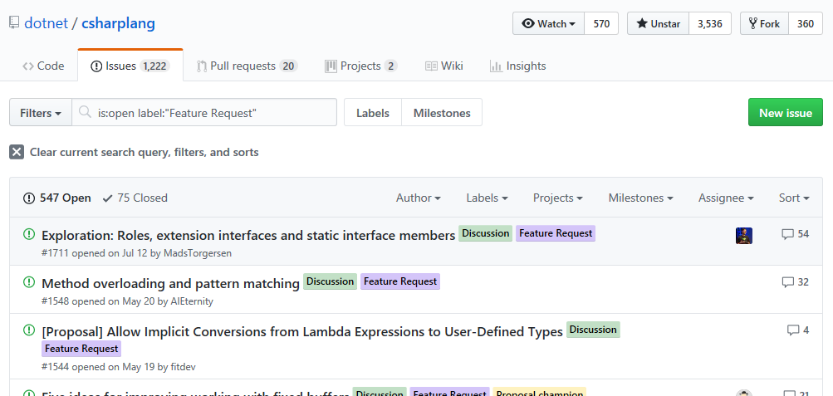
Future Directions
https://github.com/dotnet/csharplang/labels/Feature%20Request
Notes:
If you have an idea, submit a feature request and see where it goes.

Slide 55
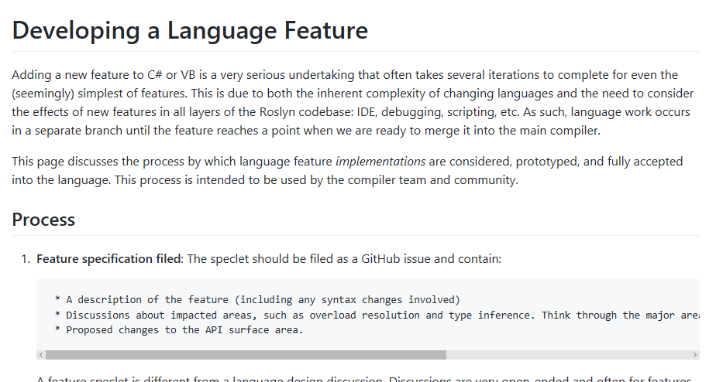
Future Directions
https://github.com/dotnet/roslyn/blob/master/docs/contributing/Developing%20a%20Language%20Feature.md
Notes:
Just follow the directions….

Slide 56

Future Directions
More expression-bodied members
http://www.wildfiresparks.co.uk/wp-content/uploads/2014/02/Influence.png
Notes:
YOU can influence the future direction if you want! The “more expressions-bodied members” was proposed and implemented by the community, so you can get involved!

Slide 57
What’s New in C#7 (and Coming in C#8)
Remember…
https://github.com/JasonBock/WhatsNewInCSharp7
https://github.com/JasonBock/WhatsNewInCSharp6
https://github.com/JasonBock/Presentations/blob/master/What%E2%80%99s%20New%20in%20C%237.pptx
References in the notes on this slide
Jason Bock
Practice Lead
Notes:
References:
Features Added in C# Language Versions - https://github.com/dotnet/csharplang/blob/master/Language-Version-History.md
C# 8: Pattern Matching Extended - https://csharp.christiannagel.com/2018/07/03/patternmatchingcs8/
Writing operators - https://github.com/akarnokd/async-enumerable-dotnet/wiki/Writing-operators
How Microsoft rewrote its C# compiler in C# and made it open source - https://medium.com/microsoft-open-source-stories/how-microsoft-rewrote-its-c-compiler-in-c-and-made-it-open-source-4ebed5646f98
Tuples, deconstruction, and dictionaries - https://twitter.com/davidpine7/status/1032706884569059328
Optimizing C# Struct Equality with IEquatable and ValueTuples - https://montemagno.com/optimizing-c-struct-equality-with-iequatable/
C# 8 - Jon Skeet and Mads Torgersen - https://www.youtube.com/watch?v=gGUYUJmssYM
The future of C# (Build 2018) - https://channel9.msdn.com/Events/Build/2018/BRK2155
Performance traps of ref locals and ref returns in C# - https://blogs.msdn.microsoft.com/seteplia/2018/04/11/performance-traps-of-ref-locals-and-ref-returns-in-c/
First steps with nullable reference types - https://codeblog.jonskeet.uk/2018/04/21/first-steps-with-nullable-reference-types/
Memory Management, C# 7.2 and Span<T> - https://speakerdeck.com/slang25/memory-management-c-number-7-dot-2-and-span
Using In Parameter Modifier - C# 7.2 - https://codewala.net/2018/03/27/using-in-parameter-modifier-c-7-2/
Essential .NET - C# 8.0 and Nullable Reference Types - https://msdn.microsoft.com/en-us/magazine/mt829270.aspx
C# 7 Series, Part 6: Read-only structs - https://blogs.msdn.microsoft.com/mazhou/2017/11/21/c-7-series-part-6-read-only-structs/
What's new in C# 7.2 - What's new in C# 7.2
Herding Nulls and Other C# Stories From the Future - https://www.infoq.com/presentations/c-sharp-future
Introducing Nullable Reference Types in C# - https://blogs.msdn.microsoft.com/dotnet/2017/11/15/nullable-reference-types-in-csharp/
What's new in C# 7.2 - https://docs.microsoft.com/en-us/dotnet/csharp/whats-new/csharp-7-2
C# 7.2: Understanding Span - https://channel9.msdn.com/Events/Connect/2017/T125
C# Language Internals - https://www.youtube.com/watch?v=1lnwO63LhRI
Dissecting the local functions in C# 7 - https://blogs.msdn.microsoft.com/seteplia/2017/10/03/dissecting-the-local-functions-in-c-7/
C# 7.1 - Everything You Need To Know - https://www.danielcrabtree.com/blog/329/c-sharp-7-1-everything-you-need-to-know
A Preview of C# 8 with Mads Torgersen - https://channel9.msdn.com/Blogs/Seth-Juarez/A-Preview-of-C-8-with-Mads-Torgersen
C# 7, 8 and Beyond: Language Features from Design to Release to IDE Support - https://www.infoq.com/presentations/csharp-7-8-language-features
Features Added in C# Language Versions - https://github.com/dotnet/csharplang/blob/master/Language-Version-History.md
Language Feature Status - https://github.com/dotnet/roslyn/blob/master/docs/Language%20Feature%20Status.md
Perusing C# 7.1 - http://davidpine.net/blog/csharp-seven-dot-one/
Exploring C# 7 - http://davidpine.net/blog/exploring-csharp-seven/
Tuples and Generics - https://magenic.com/thinking/tuples-and-generics-in-c7
Tuples and Deconstruction in C#7 - https://magenic.com/thinking/tuples-and-deconstruction-in-c7
C#7 Series
Value Tuples: https://blogs.msdn.microsoft.com/mazhou/2017/05/26/c-7-series-part-1-value-tuples/
Async Main: https://blogs.msdn.microsoft.com/mazhou/2017/05/30/c-7-series-part-2-async-main/
Default Literals: https://blogs.msdn.microsoft.com/mazhou/2017/06/06/c-7-series-part-3-default-literals/
Discards: https://blogs.msdn.microsoft.com/mazhou/2017/06/27/c-7-series-part-4-discards/
Private Protected: https://blogs.msdn.microsoft.com/mazhou/2017/10/05/c-7-series-part-5-private-protected/
Read-Only Structs: https://blogs.msdn.microsoft.com/mazhou/2017/11/21/c-7-series-part-6-read-only-structs/
Ref Returns: https://blogs.msdn.microsoft.com/mazhou/2017/12/12/c-7-series-part-7-ref-returns/
"in" Parameters: https://blogs.msdn.microsoft.com/mazhou/2018/01/08/c-7-series-part-8-in-parameters/
Ref Structs: https://blogs.msdn.microsoft.com/mazhou/2018/03/02/c-7-series-part-9-ref-structs/
Span<T> and universal memory management: https://blogs.msdn.microsoft.com/mazhou/2018/03/25/c-7-series-part-10-spant-and-universal-memory-management/
Expression – Bodied Members in C# 7.0 - http://dailydotnettips.com/2017/07/17/expression-bodied-members-in-c-7-0/
Abolishing Switch-Case Statement and Pattern Matching in C# 7.0: https://rubikscode.net/2017/06/18/abolishing-switch-case-and-pattern-matching-in-c-7-0/
C# 7 – Simplify and Improve Your Code in 2017: https://channel9.msdn.com/Events/DEVintersection/DEVintersection-2017-Orlando/DEV005
C# 7.x and 8.0: Uncertainty and Awesomeness: https://www.erikheemskerk.nl/c-sharp-7-2-and-8-0-uncertainty-awesomeness/
C# 7.1 and Beyond: Polishing Usability - https://www.erikheemskerk.nl/c-sharp-7-1-polishing-usability/
C# 7.2 and 8.0 Roadmap - https://www.infoq.com/news/2017/06/CSharp-7.2
An Early Look at C# 7.1: Part 1 - https://www.infoq.com/news/2017/06/CSharp-7.1-a
An Early Look at C# 7.1: Part 2 - https://www.infoq.com/news/2017/06/CSharp-7.1-b
The Future of C# - https://channel9.msdn.com/Events/Build/2017/B8104
What's new in C# 7 - https://docs.microsoft.com/en-us/dotnet/articles/csharp/whats-new/csharp-7
Patterns and Practices in C# 7 - https://www.infoq.com/articles/Patterns-Practices-CSharp-7
New Features in C# 7.0 - https://blogs.msdn.microsoft.com/dotnet/2017/03/09/new-features-in-c-7-0/
C#7 Tools (see other related articles from this author) - http://blog.somewhatabstract.com/2017/02/20/c7-tools/
.NET Framework - What's New in C# 7.0 - https://msdn.microsoft.com/en-us/magazine/mt790184.aspx
Nested Functions: https://en.wikipedia.org/wiki/Nested_function (think function to delete files, needs recusion, local functions makes this elegant, but is it performant?)
C# 7 Work List of Features - https://github.com/dotnet/roslyn/issues/2136
What's New in C#7 - https://blogs.msdn.microsoft.com/dotnet/2016/08/24/whats-new-in-csharp-7-0/
Language Feature Status - https://github.com/dotnet/roslyn/blob/master/docs/Language%20Feature%20Status.md
Visual Studio "15" Preview 5 - https://www.visualstudio.com/news/releasenotes/vs15-relnotes#cshappvb
Language Feature Status - https://github.com/dotnet/roslyn/blob/master/docs/Language%20Feature%20Status.md
C#.futures
Blittable and Non-Blittable Types - https://docs.microsoft.com/en-us/dotnet/framework/interop/blittable-and-non-blittable-types
Generators: https://github.com/dotnet/roslyn/blob/master/docs/features/generators.md
.NET Futures: Type Classes and Extensions - http://www.infoq.com/news/2017/04/DotNet-Type-Classes
.NET Futures: Multiple Inheritance - http://www.infoq.com/news/2017/04/Clr-Default-Methods
C# Futures: Relaxed Overrides - http://www.infoq.com/news/2017/04/CSharp-covariant-return
C# Futures: Read-Only Local Variables - http://www.infoq.com/news/2017/04/CSharp-Readonly-Locals
C# Futures: Read-Only References and Structs - http://www.infoq.com/news/2017/04/Readonly-References
.NET Futures: Type Classes and Extensions - https://www.infoq.com/news/2017/04/DotNet-Type-Classes

